Slide 1
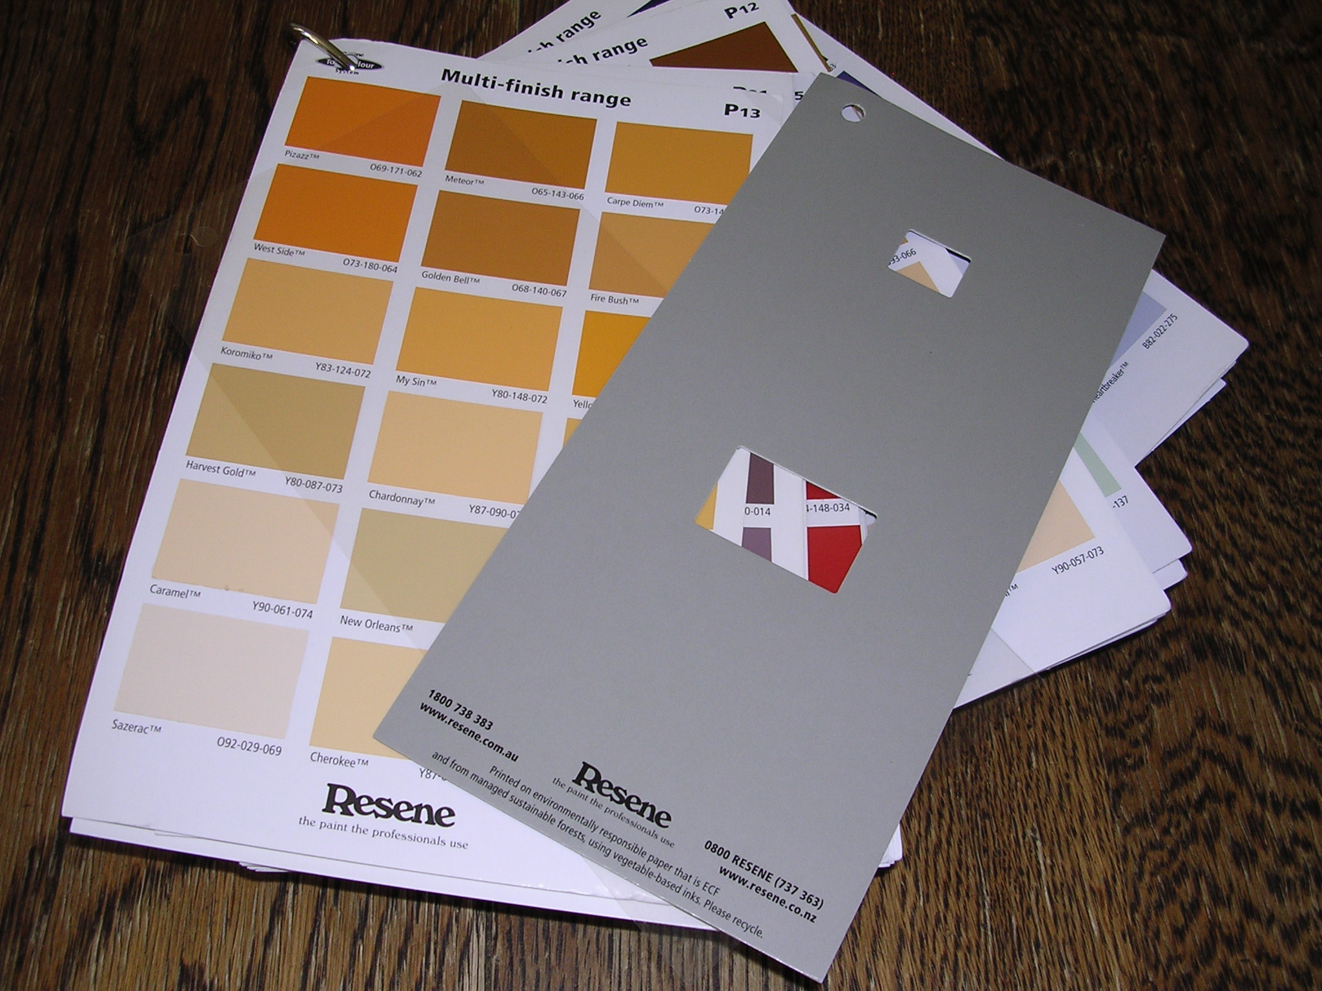
Colour charts to match colours

Slide 2
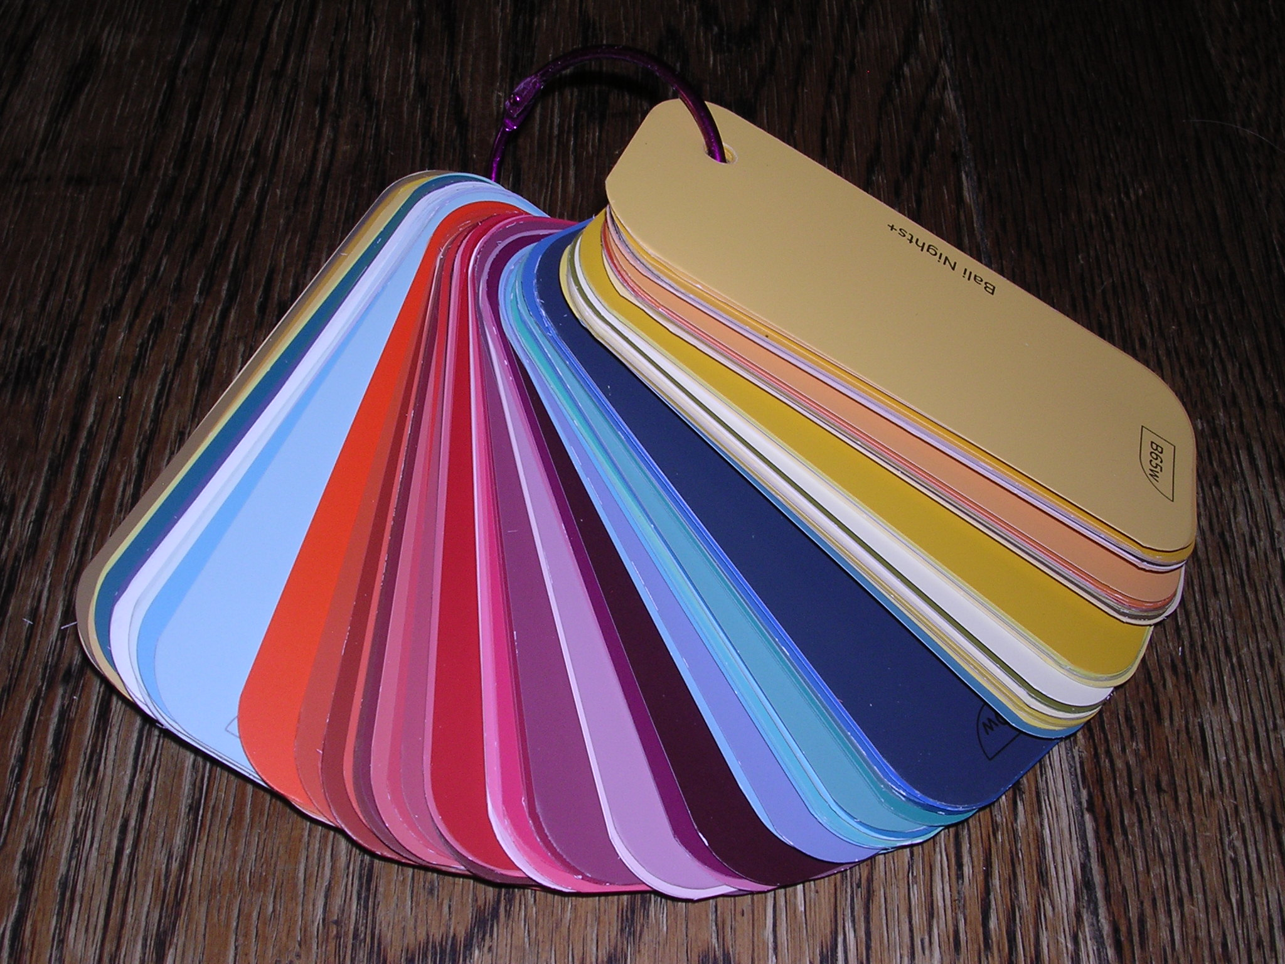
Paint colour tiles as a colour reference

Slide 3
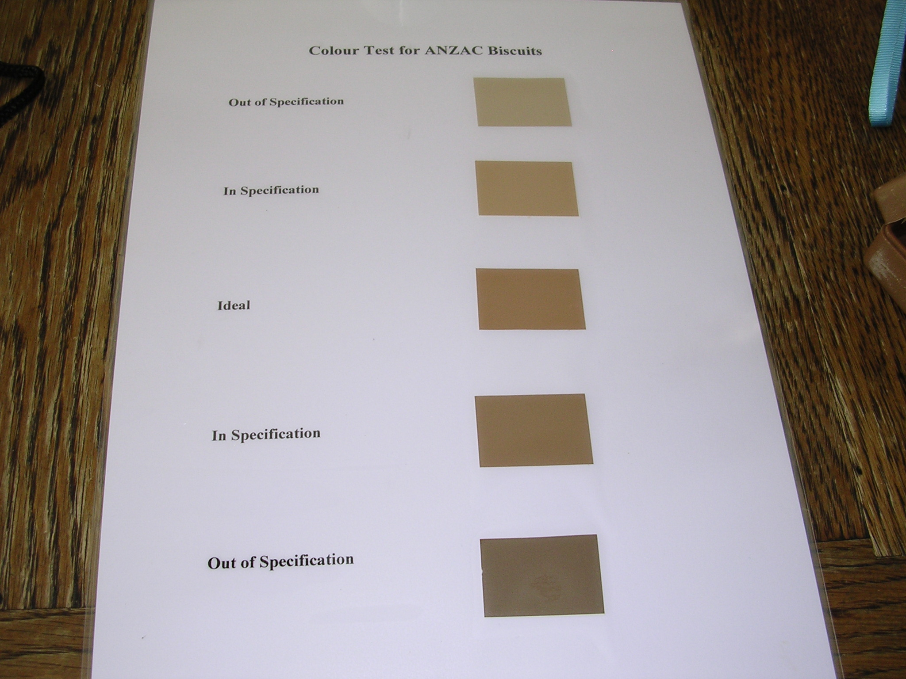
Create a product colour chart

Slide 4
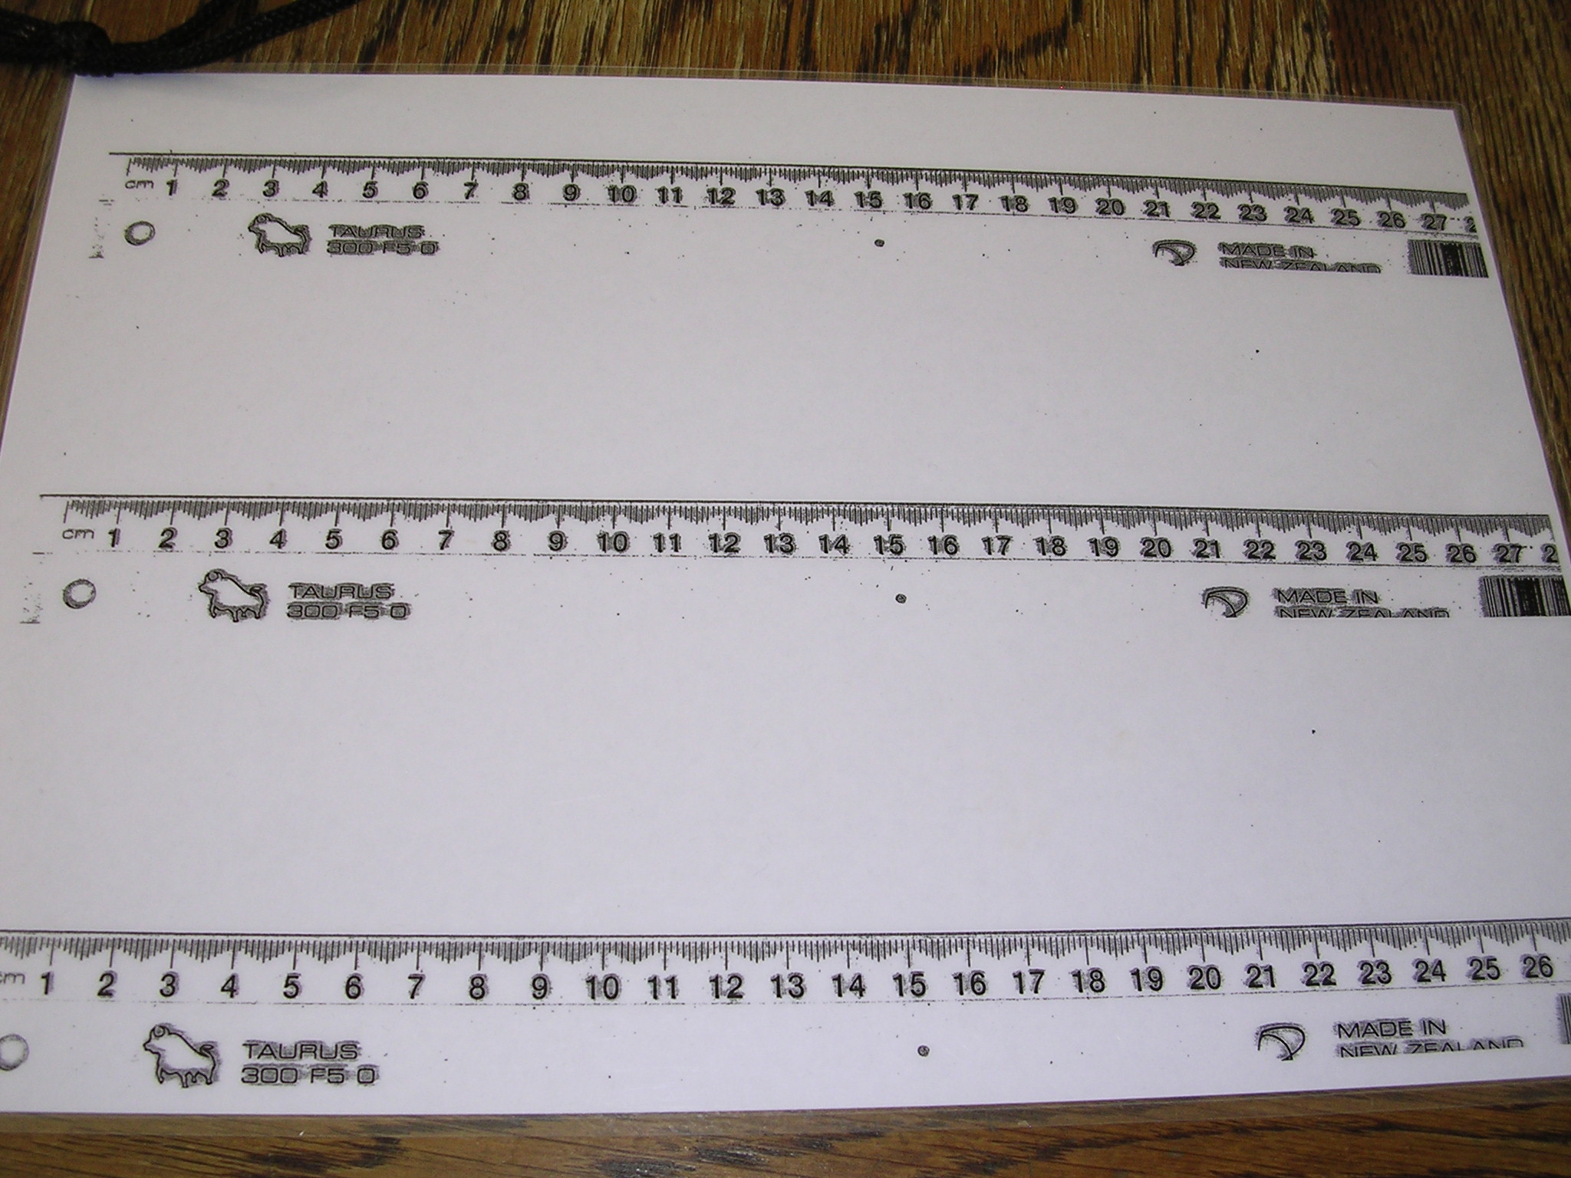
A sheet of measures to compare products

Slide 5
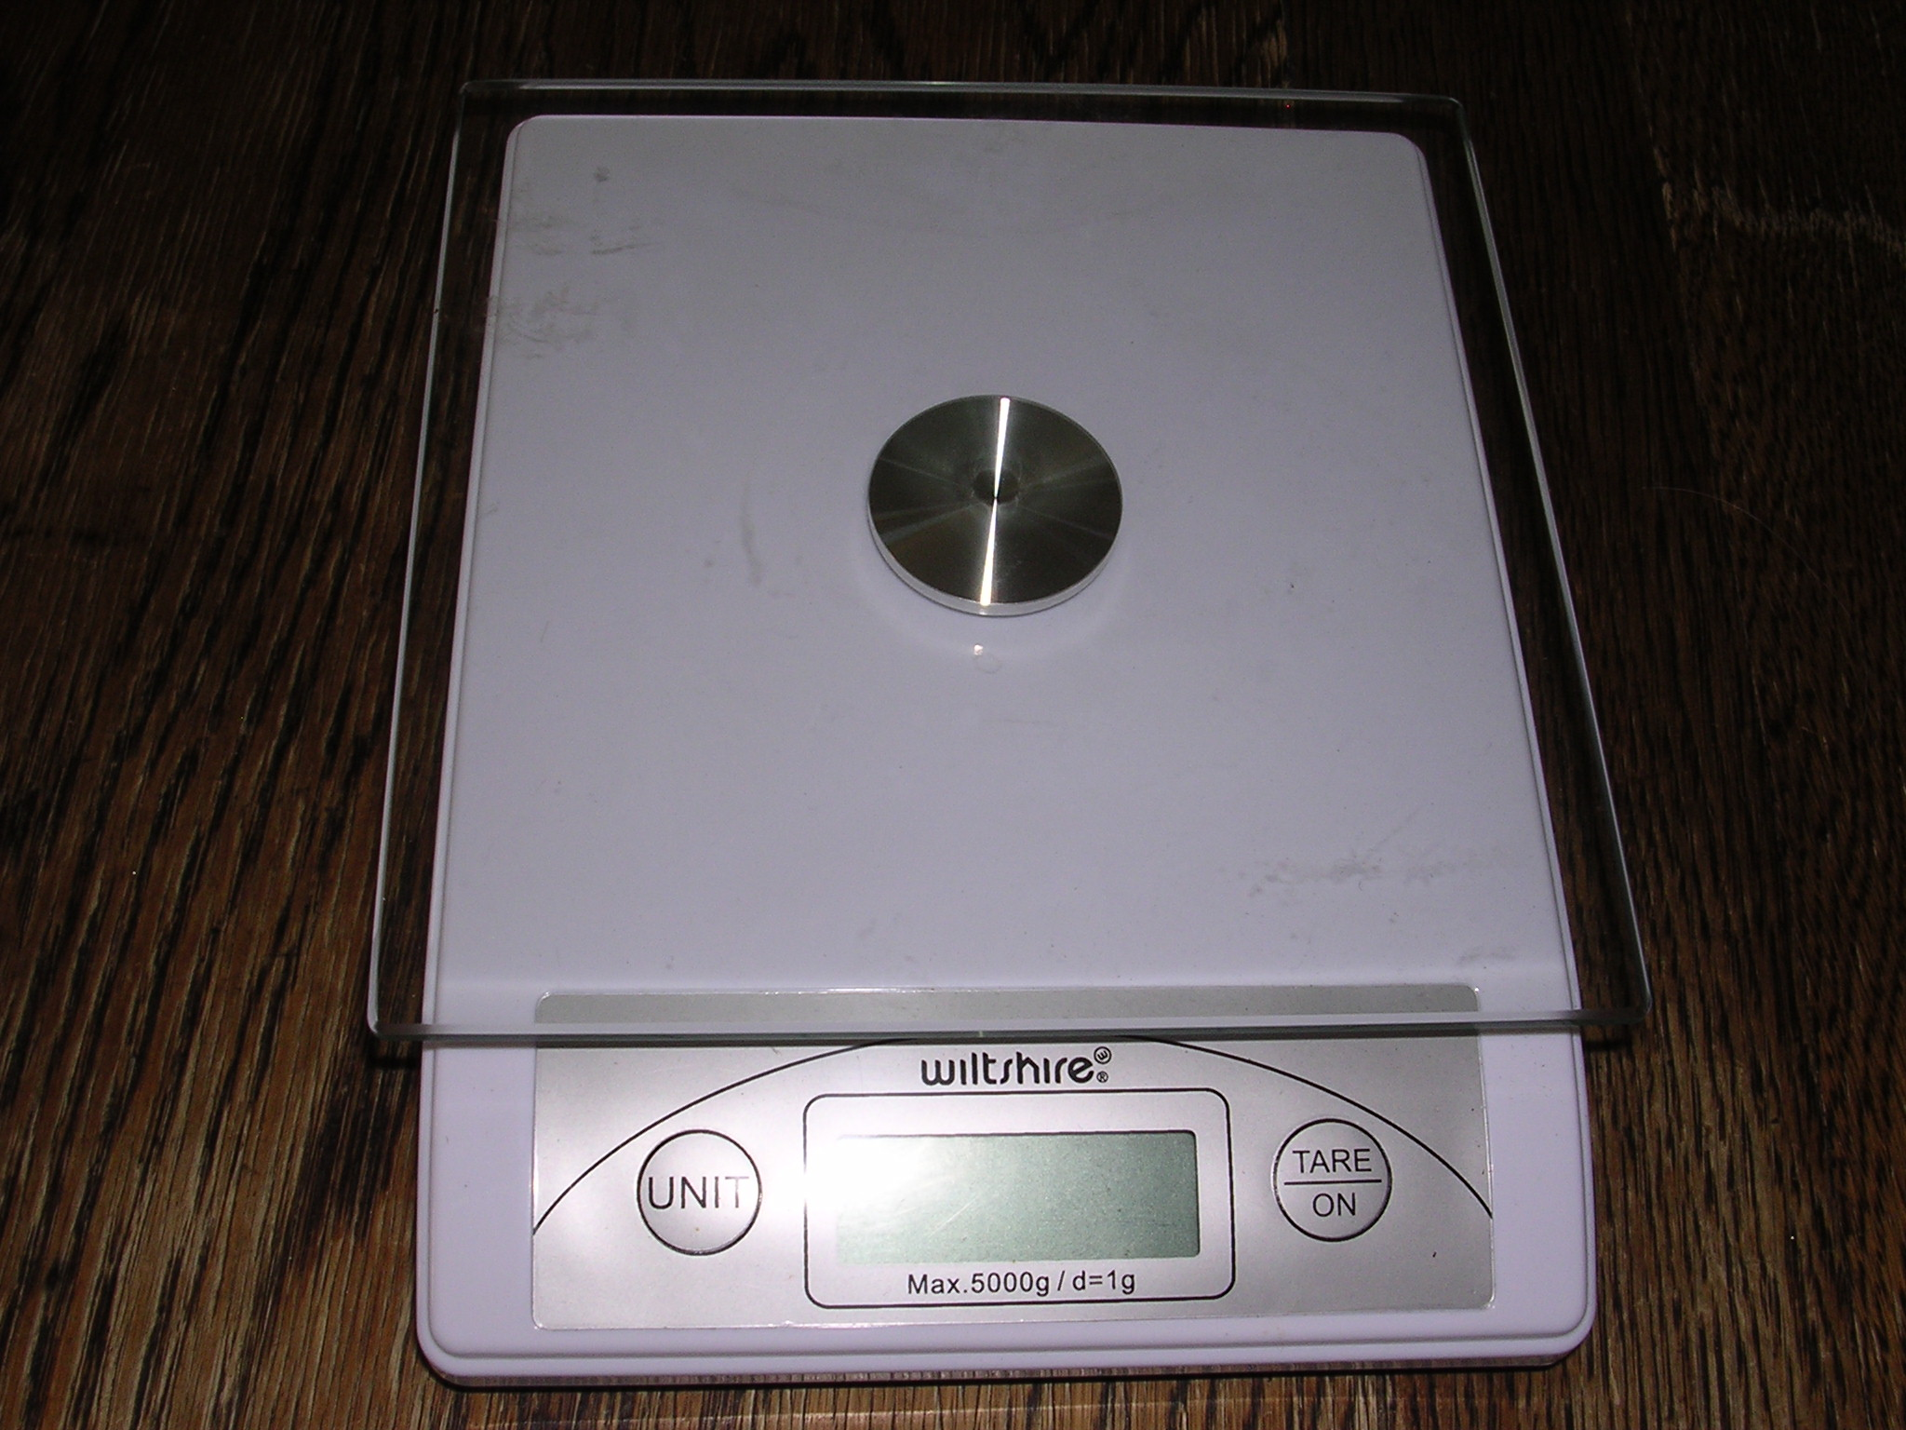
Scales with a tare

Slide 6
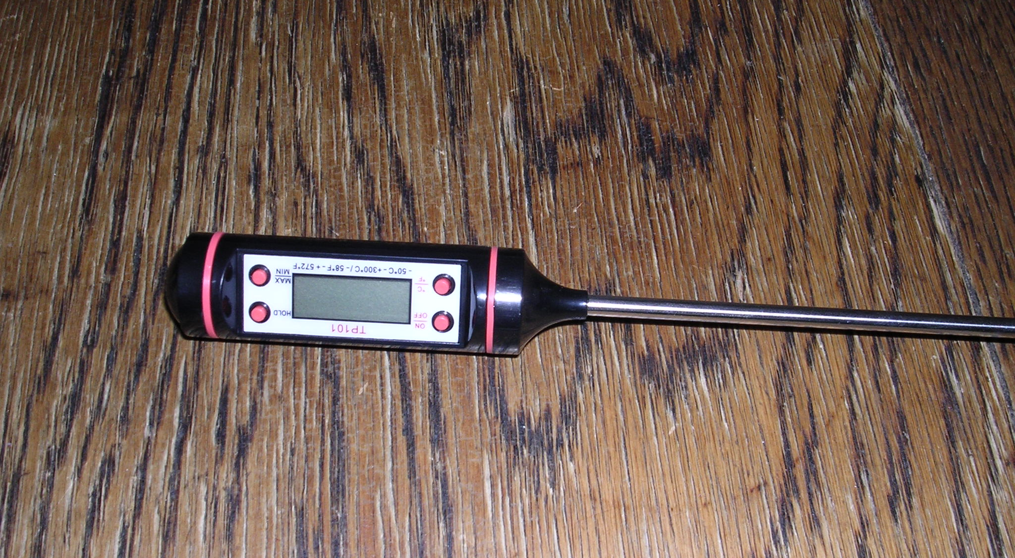
A temperature probe

Slide 7
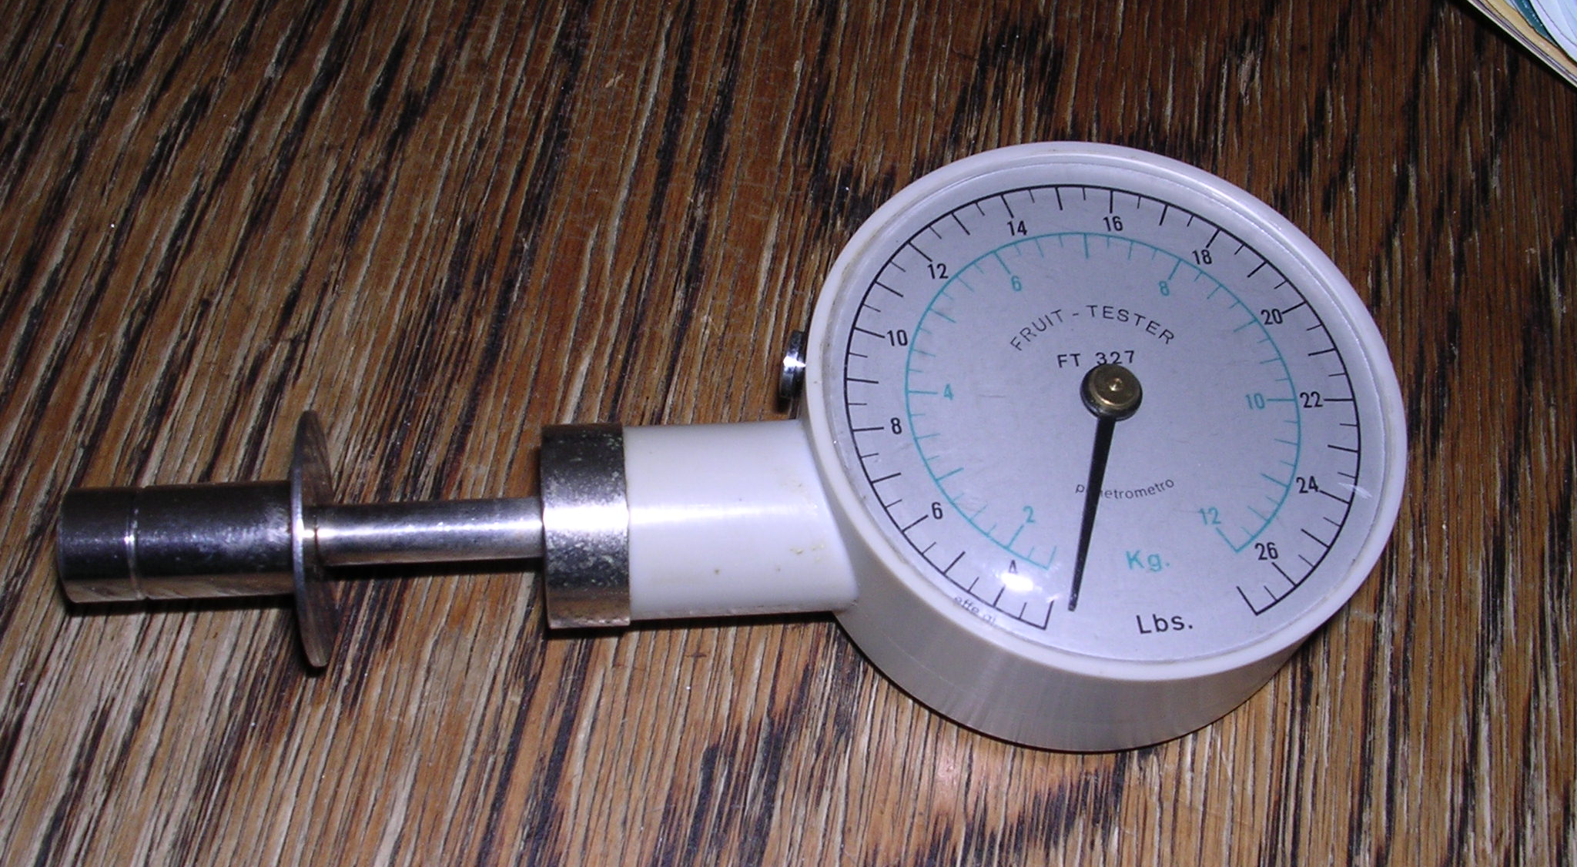
A fruit tester to measure firmness

Slide 8
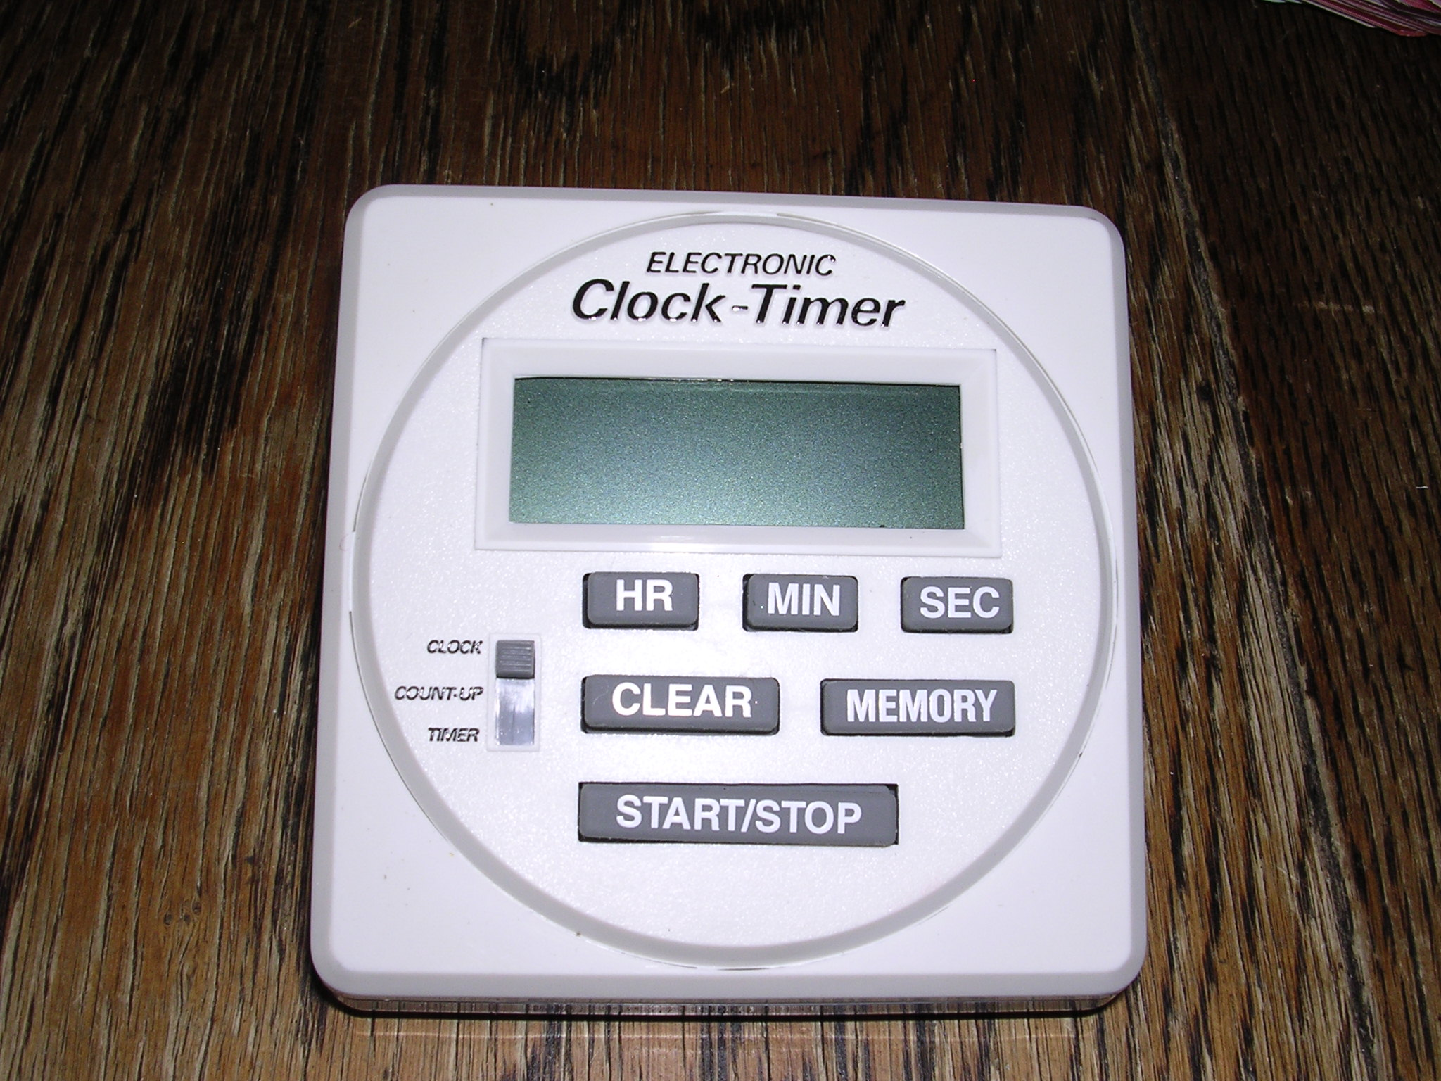
A timer

Slide 9
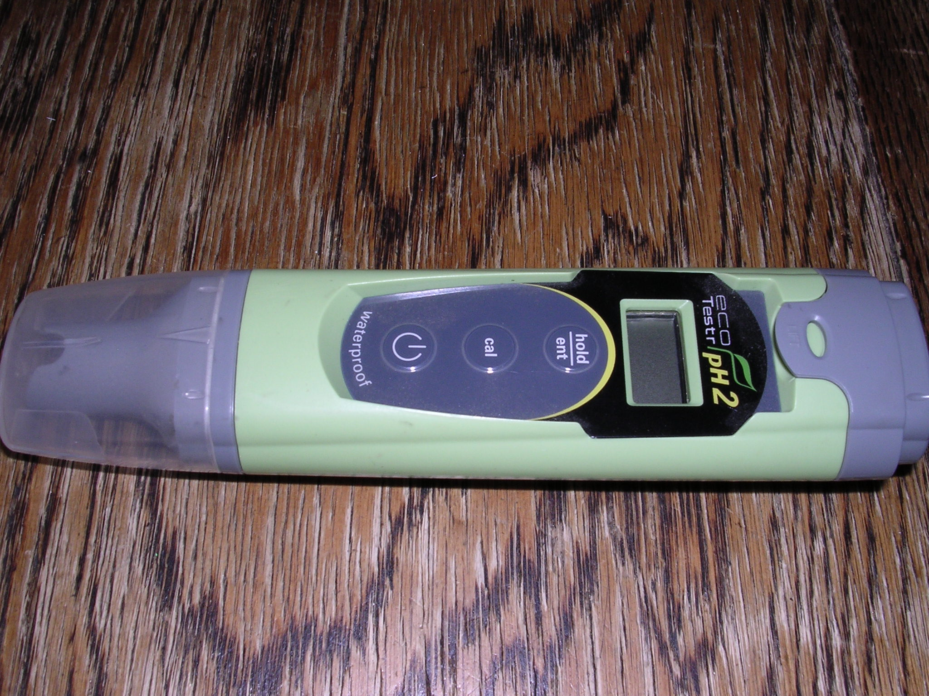
A pH tester

Slide 10
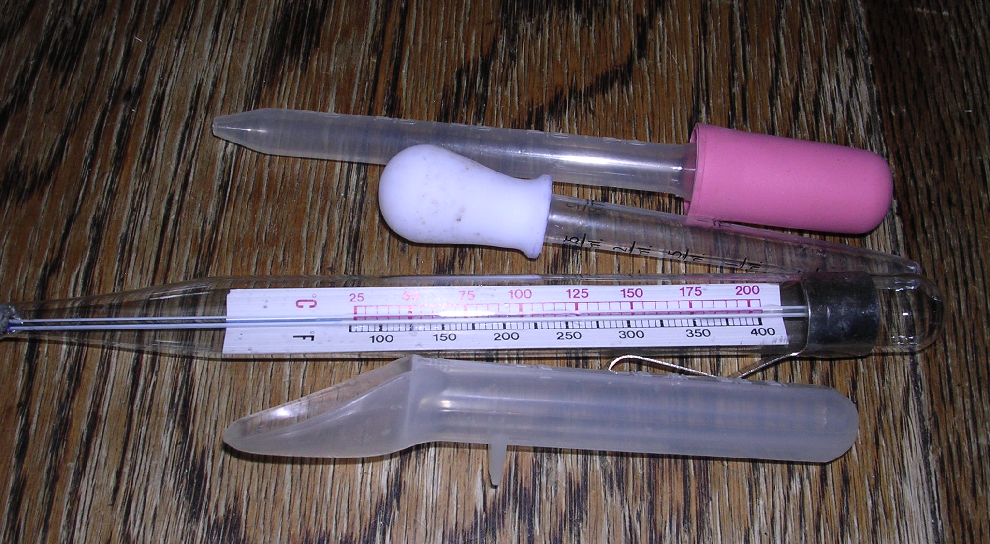
Droppers and medicine spoon

Slide 11
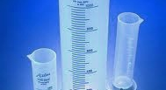
Measuring cylinders

Slide 12
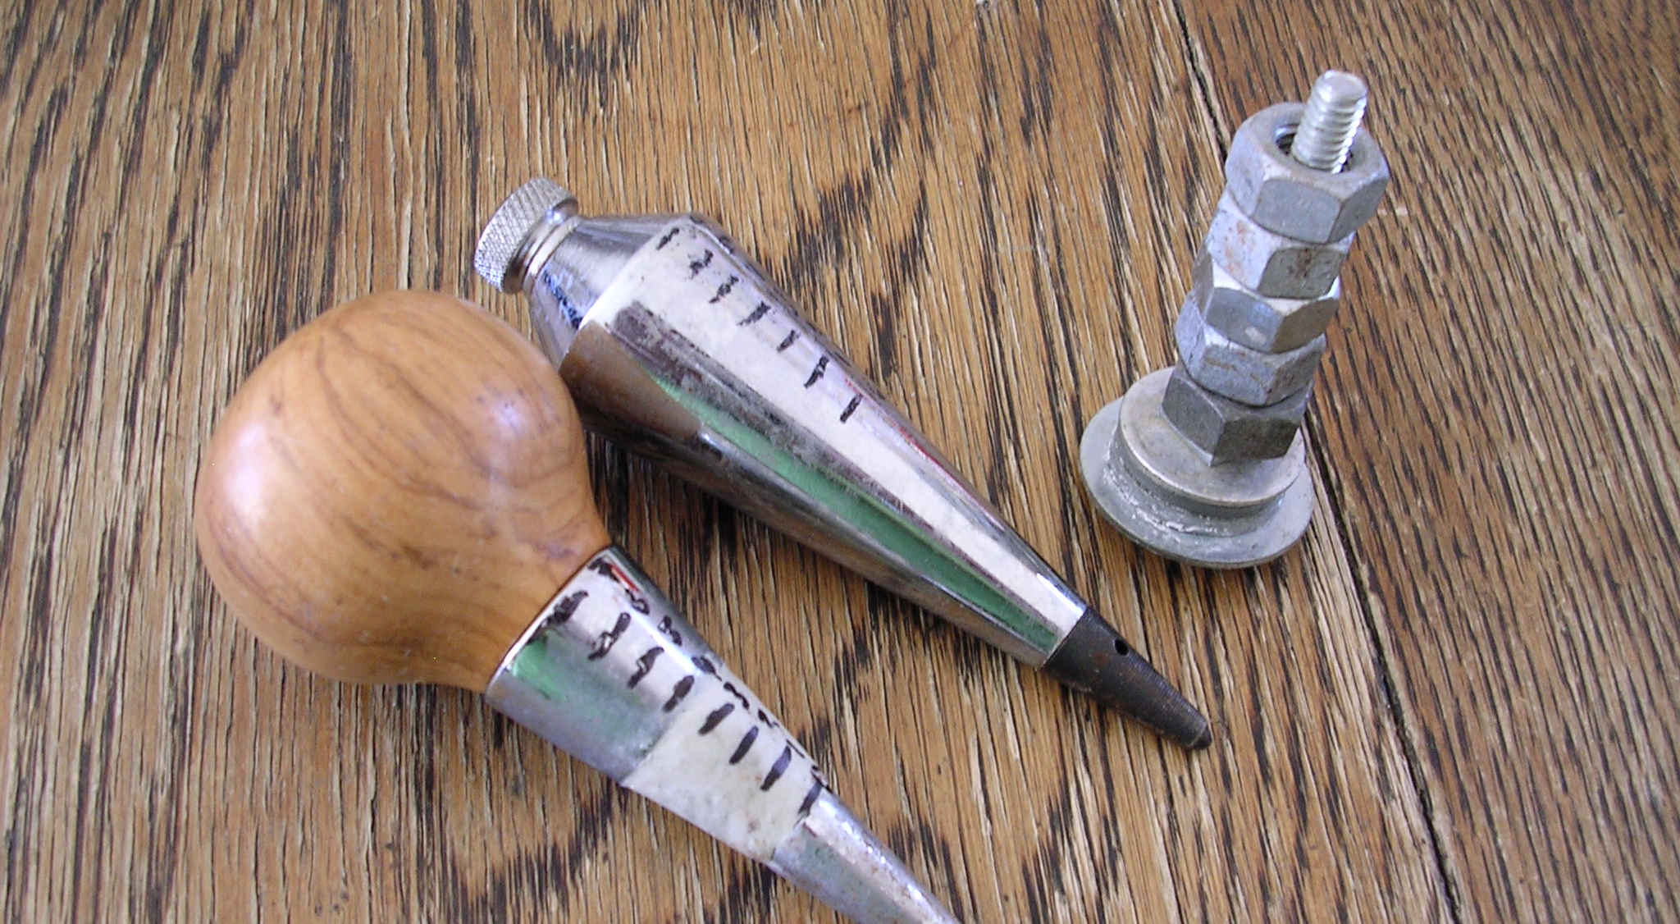
A plumb or similar (make one from nuts and bolt) to measure density

Slide 13
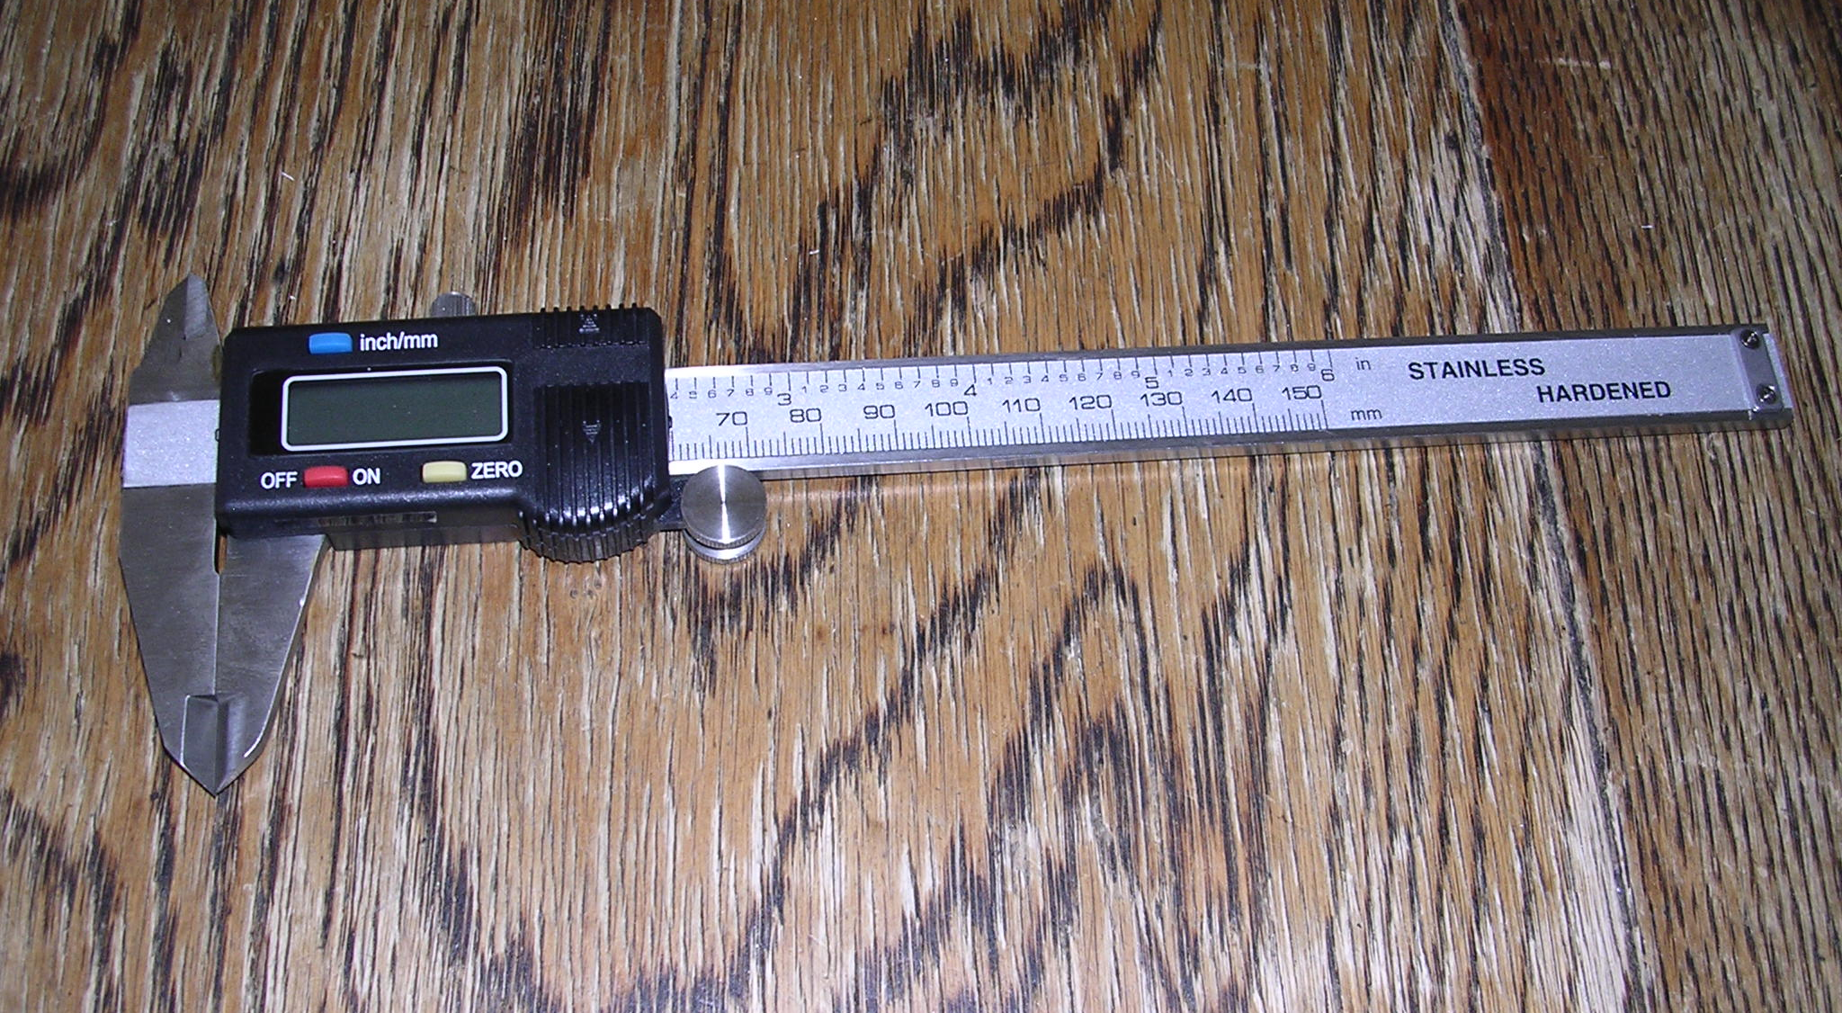
Calipers to measure thickness

Slide 14
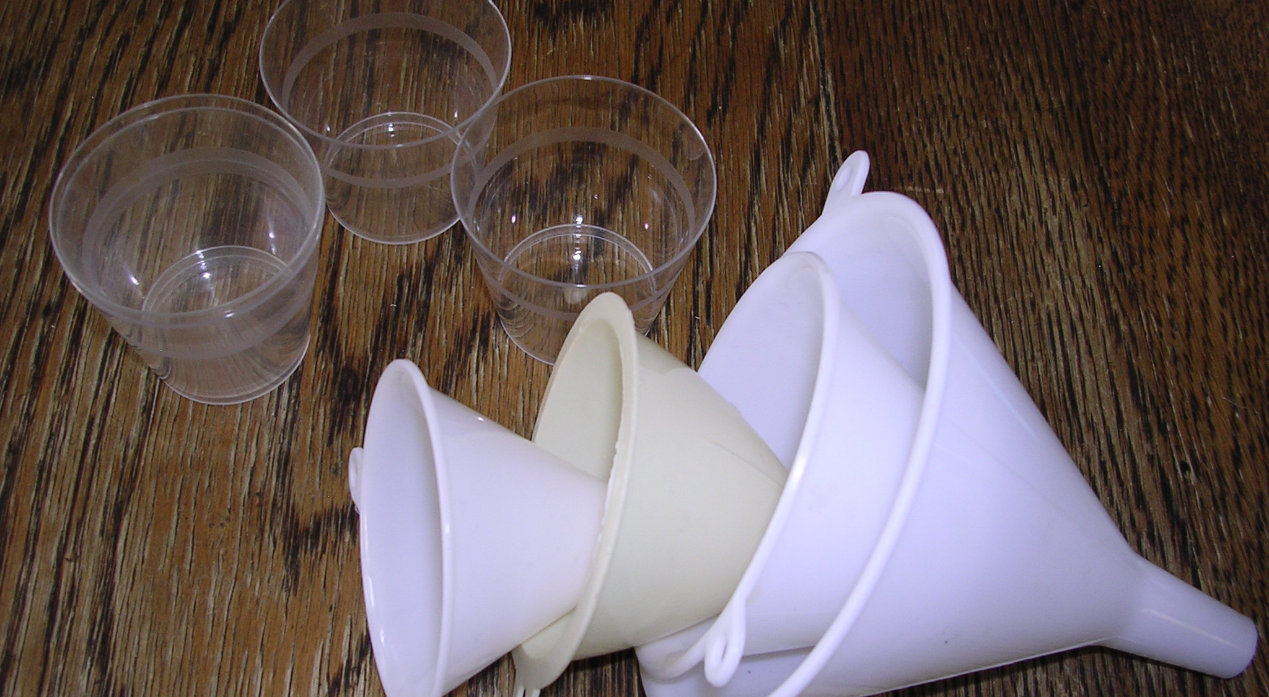
Funnels to measure viscosity

Slide 15
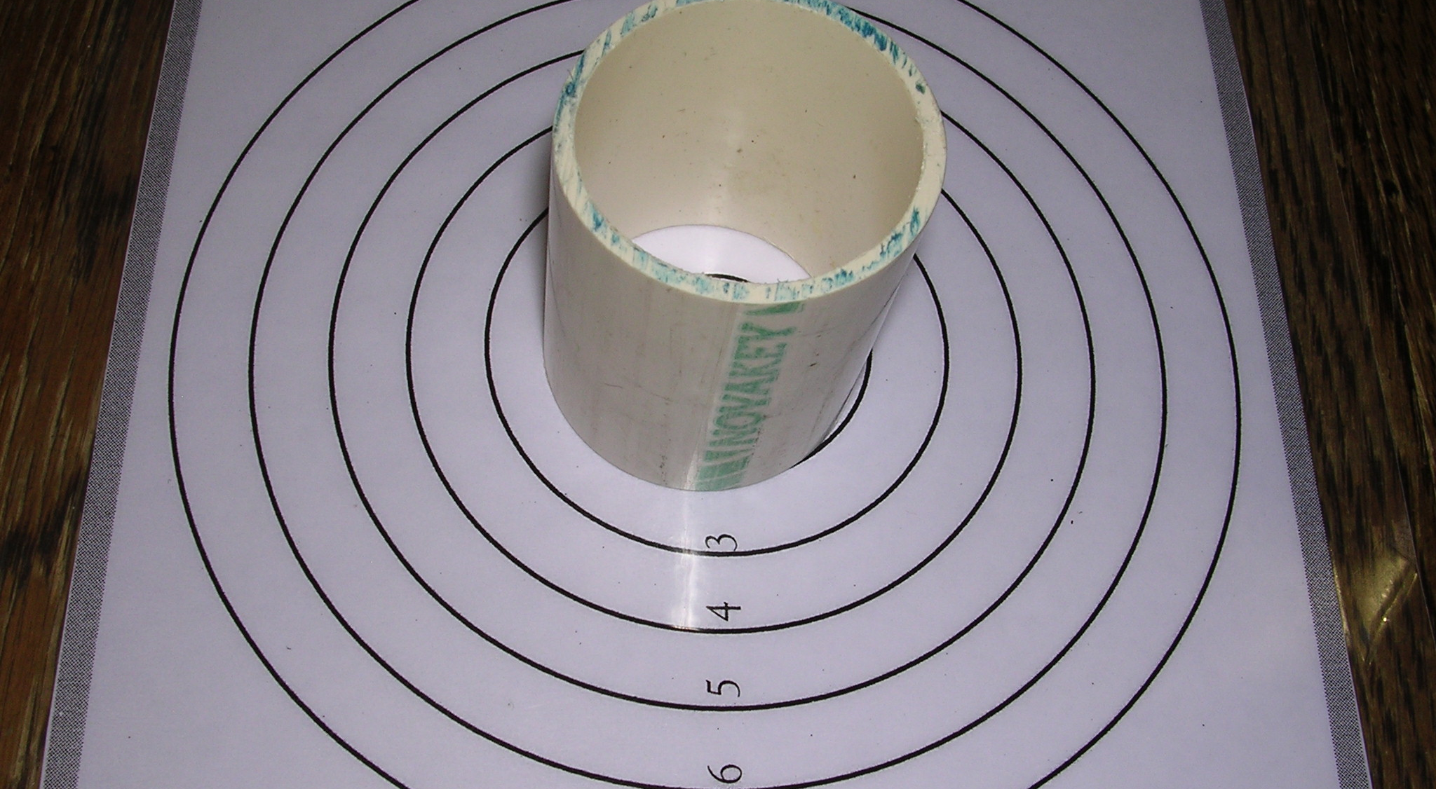
Spouting and circle mat to measure viscosity

Slide 16
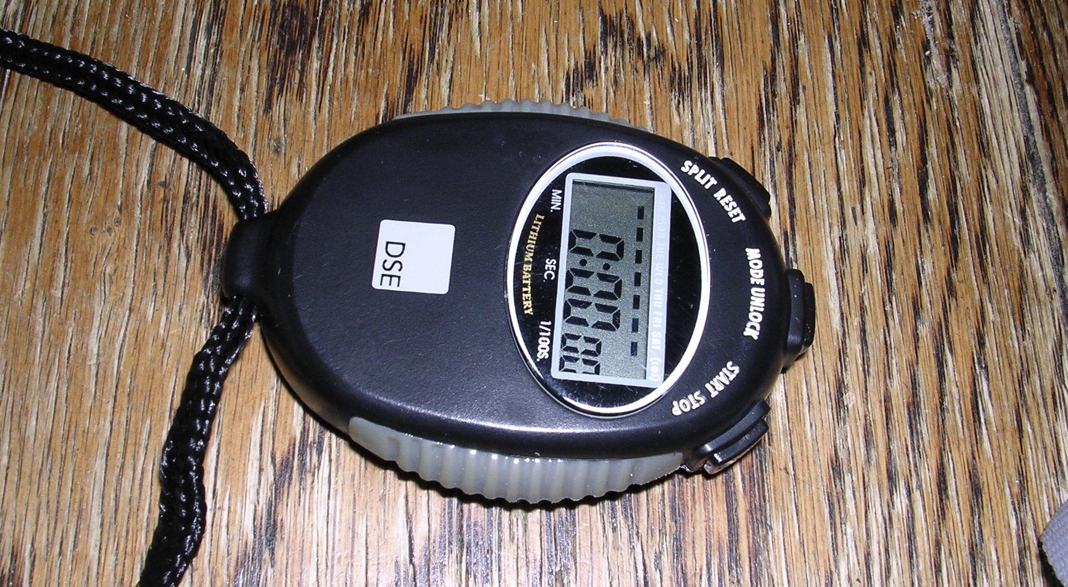
A timer

